Slide 1
Line Follower
Python with Robots Mission 6
Lesson 3 Objectives 7-8

Slide 2

Pre-Mission Warm-Up
In your Mission 6 Lesson 3 log, answer the pre-mission warm-up questions:
What code reads the line sensors and turns on/off the LEDs?
What data type (information) does ls.check() return?

Slide 3

Mission 6: Line Follower
In this project you will build and refine a line following robot.
Line followers are a staple in robotics competitions, such as races or mazes.
But even basic line followers aren’t just for competitions!
Robots that zip through warehouses often follow lines as they pick up items you order when shopping online.

Slide 4
Mission 6: Line Follower
Project Goals:
Create a basic line follower using 2-edge sensors.
Improve the design with a center-line sensor to keep it straight.
Use all 5 sensors for proportional steering control.

Slide 5
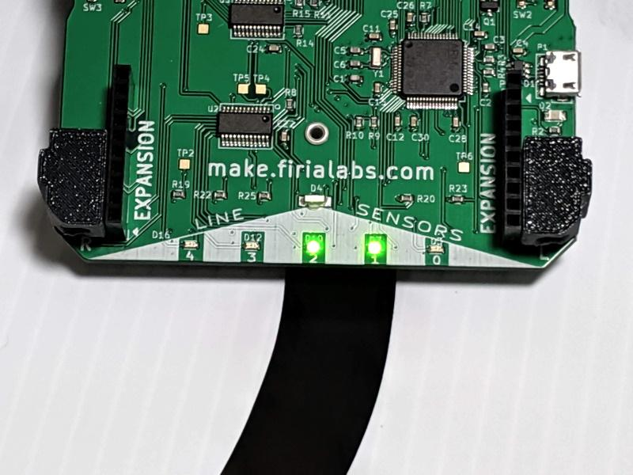
Mission 6: Line Follower
For this lesson, we will complete the final task:
Use all 5 sensors for proportional steering control.

Slide 6
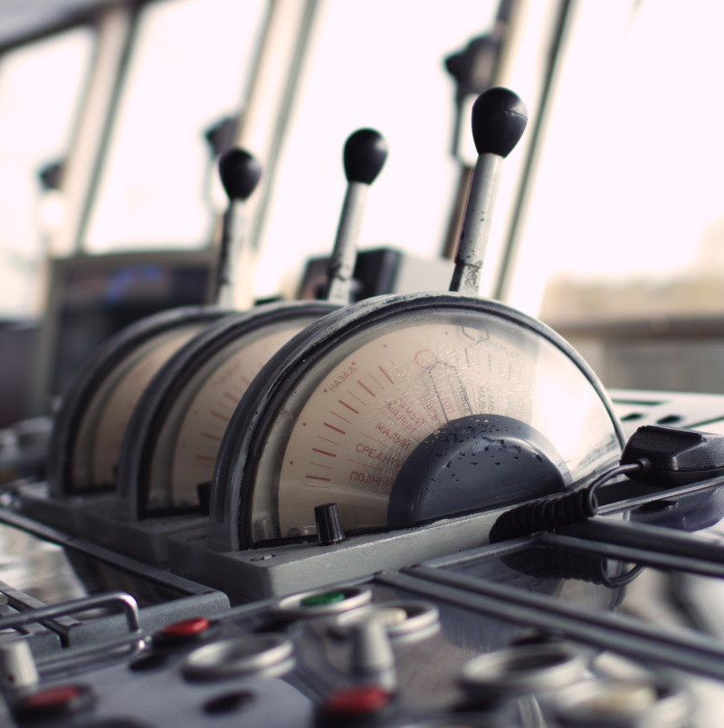
Objective #7: Proportional Control
Open your LineFollow program.
Review the code.
The line sensors are read, and LEDs are turned on/off.
Each line sensor is used individually to control the ‘bot.
The ‘bot always moves or turns at the same speed.

Slide 7
Objective #7: Proportional Control
We can use the line sensors for smarter turning control.
Turn gently on curvy sections.
Make a sharp turn on sharp bends.
On straight paths, go fast!
With five sensors, you can detect much more than left or right edge!

Slide 8
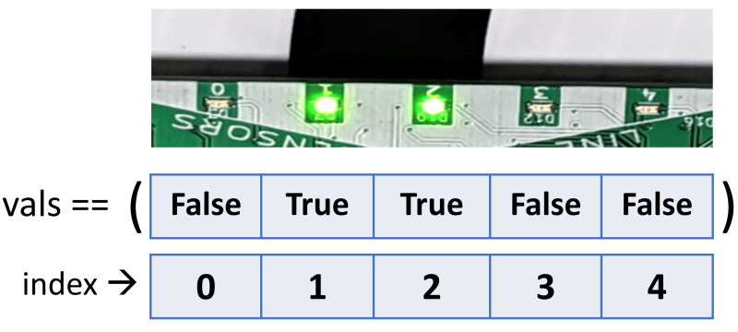
Objective #7: Proportional Control
Think about different tuples of line detection:
Far left only: (True, False, False, False, False)
Some left: (True, True, False, False, False)
Some right: (False, False, False, True, True)
Far right only: (False, False, False, False, True)

Slide 9
Objective #7: Proportional Control
For each case, you want to turn slightly differently.
Far left only: (True, False, False, False, False) - turn left!
Some left: (True, True, False, False, False) - curve left
Some right: (False, False, False, True, True) - curve right
Far right only: (False, False, False, False, True) - turn right!

Slide 10
Objective #7: Proportional Control
To have more control, we will need a function for driving that lets us use different speeds.
Define a function in your program for driving.

Slide 11
Objective #7 Activity
DO THIS:
Open the LineFollow program.
Define a function for drive().
Use parameters for left speed and right speed.
Functions are often defined near the top of the code, under the variables and constants.

Slide 12
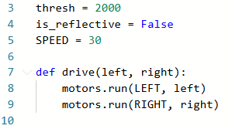
Objective #7 Activity
DO THIS:

Slide 13
Objective #7: Proportional Control
Back to your detection chart! You can assign speeds for each case. But that is a lot of typing.
Far left only: (True, False, False, False, False) - turn left!
Some left: (True, True, False, False, False) - curve left
Some right: (False, False, False, True, True) - curve right
Far right only: (False, False, False, False, True) - turn right!

Slide 14
Objective #7: Proportional Control
Concept: Using Boolean numbers for True/False
A computer only uses numbers.
True is represented with 1
False is represented with 0
So (True, True, False, False, False) is the same as
(1, 1, 0, 0, 0)

Slide 15
Objective #7 Activity
DO THIS:
Go to your mission log.
Practice representing Boolean tuples with 1s and 0s.

Slide 16
Objective #7: Proportional Control
Back to your detection chart!
Let’s assign speeds (left, right) for each case.
Far left only: (1, 0, 0, 0, 0) – turn to the left! – use (0, 30)
Some left: (1, 1, 0, 0, 0) – curve to the left – use (15, 30)
Some right: (0, 0, 0, 1, 1) – curve to the right – use (30, 15)
Far right only: (0, 0, 0, 0, 1) – turn to the right! – use (30, 0)

Slide 17
Objective #7 Activity
DO THIS:
Modify your code to set left/right speeds for each case by calling the drive function.
Include each case you identified.
You can use the entire vals tuple in the condition!
Like this: if vals == (1, 0, 0, 0, 0):

Slide 18
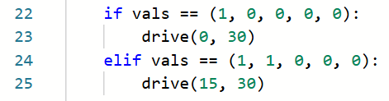
Objective #7 Activity
DO THIS:
Here is an example of the left turns.
You can use your own speeds.
Don’t forget to add the right turns as well.

Slide 19
Objective #7: Proportional Control
Let’s add more cases to the detection chart!
What about when the ‘bot is on the line?
Slightly left: (0, 1, 1, 0, 0) – slightly less left than right
Slightly right: (0, 0, 1, 1, 0) – slightly more left than right
In the center: (0, 0, 1, 0, 0) – Both wheels same speed

Slide 20
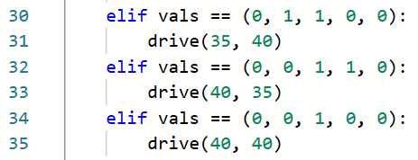
Objective #7 Activity
DO THIS:
Include these detection cases in your code.
For example:

Slide 21
Objective #7 Activity
Try it:
Place the ‘bot on a track.
Run the code.
Try different tracks to see how the ‘bot does.
Make adjustments. You could:
  Change the left/right speeds
  Add more detection tuples

Slide 22
Objective #8: Read the Line
Your line follower rocks!
A final step to the project is to make your ‘bot adapt to its environment.
The current program sets the values for threshold and is_reflective.
They are set for a black line on a white surface.

Slide 23
Objective #8: Read the Line
But what if the line is different?
A new track may have a white line on a dark road.
Then you would have to go into the code and change the values of threshold and is_reflective.
Can you make the code sense the line and set the values for you?

Slide 24
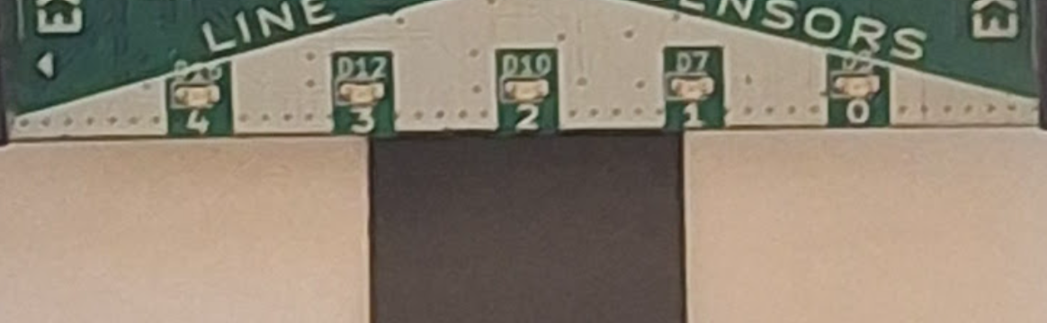
Objective #8: Read the Line
YES!
Write a new function that will calibrate the threshold and is_reflective before CodeBot’s journey begins.
To calibrate, the ‘bot must be placed so that the middle sensor [2] is on the line and the left sensor [0] is off the line.

Slide 25
Objective #8 Activity
DO THIS:
Let’s get started.
Define a new function for calibration.
Read the line sensors.
For this function, you need the actual integer readings, not True/False.
Use ls.check(0)
  Remember this from Lesson 2?

Slide 26

Objective #8 Activity
DO THIS:

Slide 27
Objective #8 Activity
DO THIS:
We only need two of the readings:
the center and the far left.
Assign each value to a variable.
Then we want to know the difference (gap). This will help calculate the threshold.

Slide 28
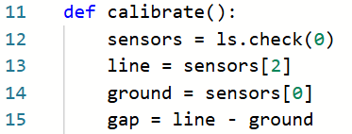
Objective #8 Activity
DO THIS:

Slide 29
Objective #8: Read the Line
The gap is the result of subtraction:
it can be positive or negative.
If the gap is small, there isn’t enough of a difference in the line and ground to follow the line.
You can use this condition:
if gap > -500 and gap < 500:
# not enough gap!

Slide 30
Objective #8: Read the Line
Or you can use the absolute value of gap.
There is a pre-coded function for absolute value.
if abs(gap) < 500:
# not enough gap!

Slide 31

Objective #8 Activity
DO THIS:
Add code to check the gap.
If it is too small (less than 500), play a short beep.
Remember to import sleep!

Slide 32
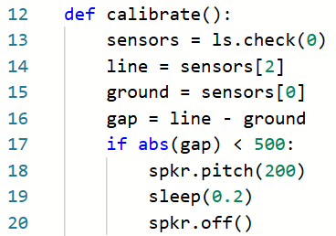
Objective #8 Activity
DO THIS:

Slide 33
Objective #8: Read the Line
Now we are ready for the calibration math.
First calculate is_reflective.
This is a Boolean value: True or False.
A condition returns a True or False.
You can use a condition to set is_reflective.

Slide 34


Objective #8: Read the Line
It works like this:
A white line has a much lower value than a black line.
A black line has a much higher value than a white line.

Slide 35
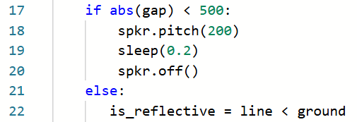
Objective #8 Activity
DO THIS:
Add code to set is_reflective.

Slide 36
Objective #8: Read the Line
Next calculate thresh.
The threshold should be halfway between line and ground.
Use half the gap.
Add it to the ground.
Then make sure it is an integer by using the round() function.

Slide 37

Objective #8 Activity
DO THIS:
Add code to set thresh.

Slide 38
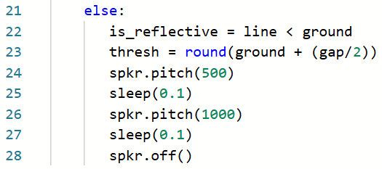
Objective #8 Activity
DO THIS:
Add two beeps to indicate the calibration is finished.

Slide 39

Objective #8: Read the Line
You are ALMOST ready to call the function.
The function calibrate() sets the values for two variables: thresh and is_reflective.
They are local!
You need them to be global.

Slide 40
Objective #8: Read the Line
Concept: Locals and Globals
Variables defined (created) inside functions are local.
They only exist while the function is running.
Then they go away.
That’s local scope.
A local variable cannot be used or accessed outside the function.

Slide 41
Objective #8: Read the Line
Concept: Locals and Globals
Variables defined (created) outside a function are global.
They exist the whole time a program is running.
They can be used and accessed anywhere.
That’s global scope.

Slide 42
Objective #8: Read the Line
Concept: Locals and Globals
When a variable is defined in a function, it is local.
But what if you need it to be global?
thresh and is_reflective are global variables.
Use the global keyword at the beginning of the function.
Example:
The variables can be listed in any order.

Slide 43
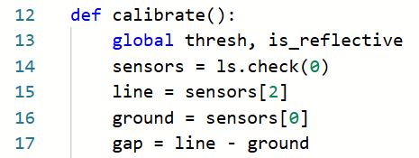
Objective #8 Activity
DO THIS:
Make the variables global.

Slide 44
Objective #8: Read the Line
Finally!
Write code to call the calibrate() function.
You can do this in the safety feature, before the line follower starts.

Slide 45
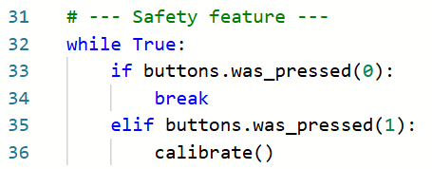
Objective #8 Activity
DO THIS:
Use a button press to call calibrate().

Slide 46
Objective #8 Activity
Try it:
Place the ‘bot on a track.
Press BTN-1 to calibrate.
Press BTN-0 to start line following.
Try different tracks to see how the ‘bot does.
Calibrate the ‘bot for each track.
Make adjustments.

Slide 47

Mission quiz
Now …. time for a quiz!
Answer the three quiz questions in CodeSpace.
CODEX
QUIZ

Slide 48

Extensions
Here are two additional elements you can add to your program:
Add code for pressing BTN-1 to stop the program (break).
Add a sound when the ‘bot turns left, a sound when the ‘bot turns right, and a different sound (or no speaker) when the ‘bot moves forward.

Slide 49
Post-Mission Reflection
Complete the post-mission reflection in your Mission 6 Lesson 3 Log:
What did you learn about programming by completing this mission?
What did you learn about yourself from completing this mission?

